Slide 1
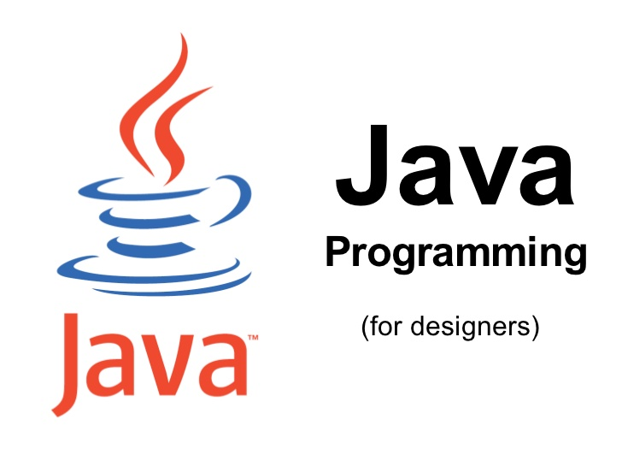

Slide 2
Summary
Evolution/history of java and it forces that shaped it
Basics of a java program
Data types, variables and control structures
Strong Typing
Function overloading
New operator
Garbage collector
Define References

Slide 3
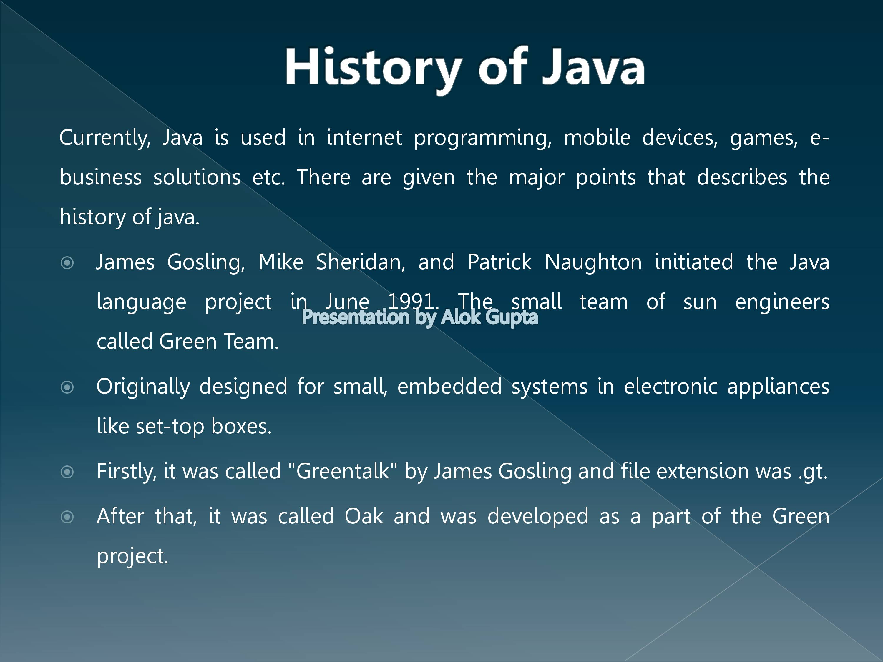

Slide 4
Oak was renamed Java in 1994 after a trademark search revealed that Oak was used by Oak Technology. Java 1.0 was finally shipped in 1996.
OOP languages are:
Significant object-oriented languages include: (list order based on TIOBE index) Java, C++, C#, Python, R, PHP, Visual Basic.NET, JavaScript, Ruby, Perl, Object Pascal, Objective-C, Dart, Swift, Scala, Kotlin, Common Lisp, MATLAB, and Smalltalk.

Slide 5
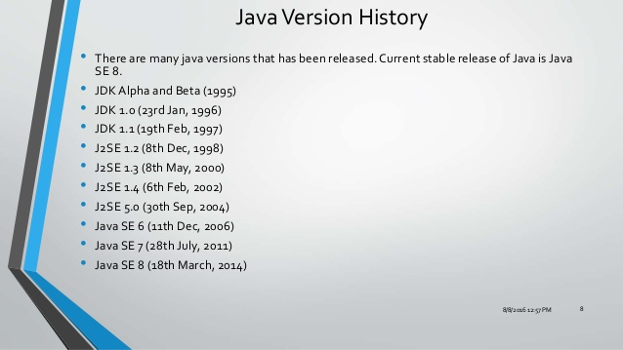

Slide 6
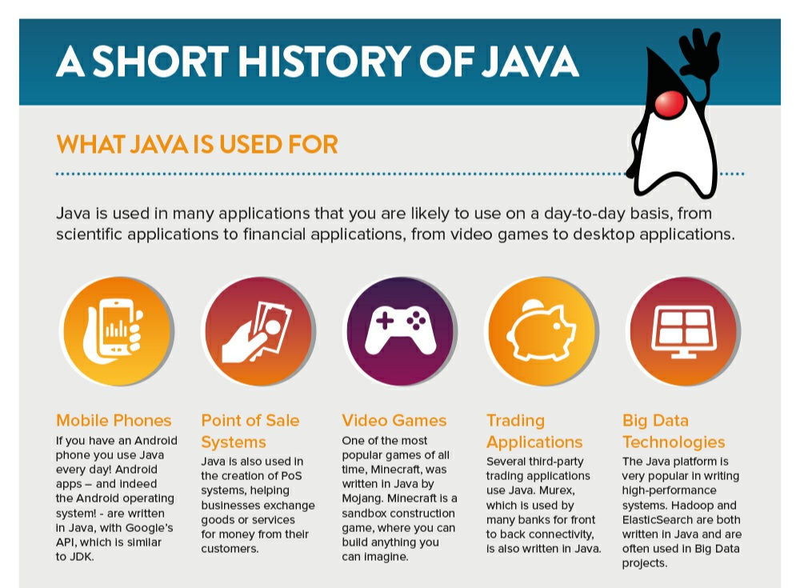

Slide 7
Evaluation of JAVA
The development of each programming language is based on a fact: there is a need to solve a problem that was not resolved by previous programming languages. Early programmers had to choose different programming languages, usually for various tasks, such as a specific language for a type of field.

Slide 8
C is a processor-oriented programming language; it is easy to execute and understand. C became quite famous at that time because it was reliable, simple and easy to use.
Though C was a quite efficient and successful programming language, the complexity of the program was seeking more efficient language to solve problems.
C++ came with object-oriented programming features. C++ is the extension of C language which has been used extensively. It is a powerful modern language that includes the power and simplicity of C and the characteristics of OOP. C++ provides more functional software benefits than C.

Slide 9
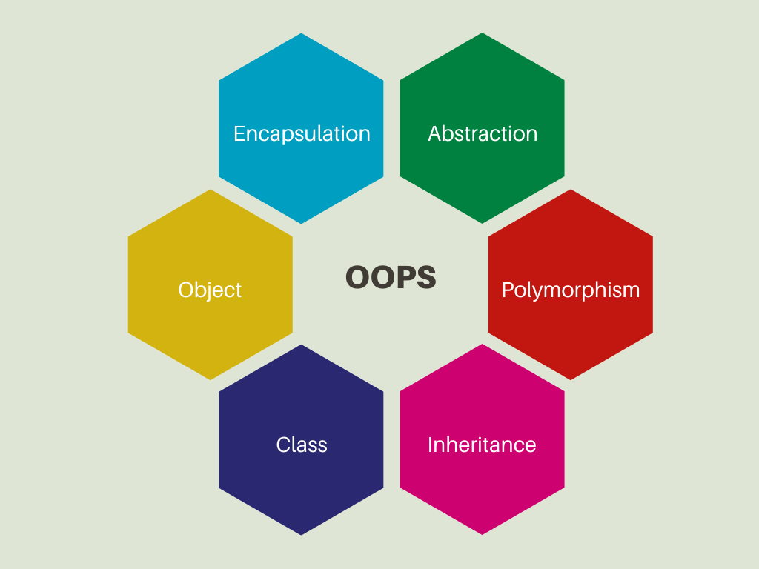

Slide 10
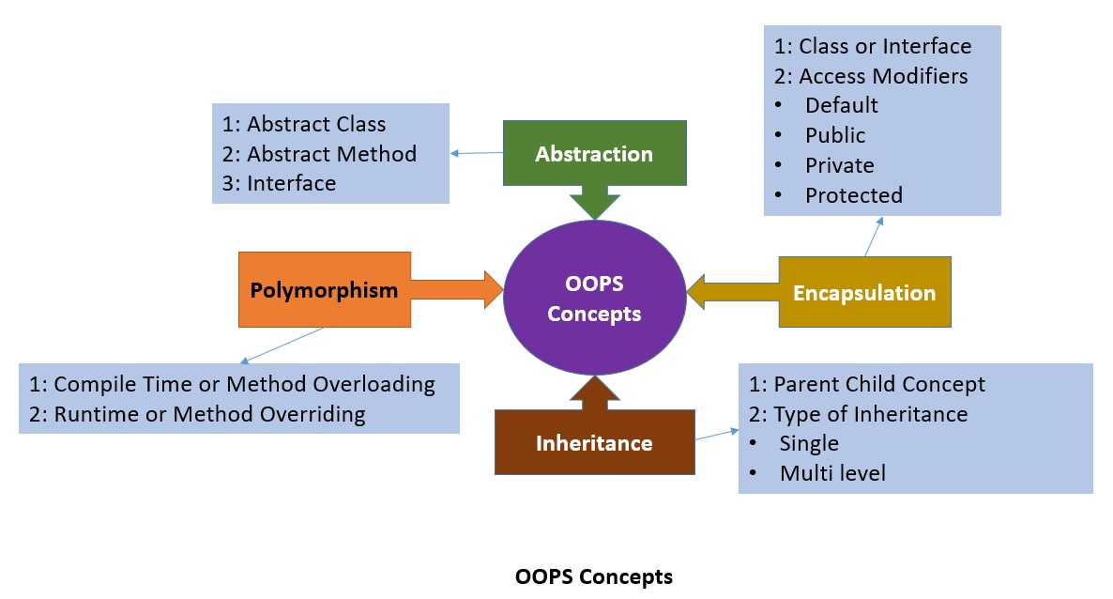

Slide 11
Programming Language
Java is a class-based, object-oriented programming language that is designed to have as few implementation dependencies as possible. ... Java applications are typically compiled to bytecode that can run on any Java virtual machine (JVM) regardless of the underlying computer architecture.

Slide 12
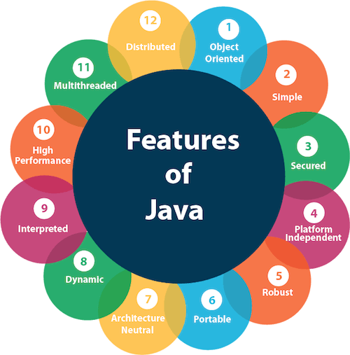

Slide 13
Object Oriented − In Java, everything is an Object. Java can be easily extended since it is based on the Object model.
Platform Independent − Unlike many other programming languages including C and C++, when Java is compiled, it is not compiled into platform specific machine, rather into platform independent byte code. This byte code is distributed over the web and interpreted by the Virtual Machine (JVM) on whichever platform it is being run on.

Slide 14
Simple − Java is designed to be easy to learn. If you understand the basic concept of OOP Java, it would be easy to master.
Secure − With Java's secure feature it enables to develop virus-free, tamper-free systems. Authentication techniques are based on public-key encryption.
Architecture-neutral − Java compiler generates an architecture-neutral object file format, which makes the compiled code executable on many processors, with the presence of Java runtime system

Slide 15
Portable − Being architecture-neutral and having no implementation dependent aspects of the specification makes Java portable. Compiler in Java is written in ANSI C with a clean portability boundary, which is a POSIX subset.
Robust − Java makes an effort to eliminate error prone situations by emphasizing mainly on compile time error checking and runtime checking.
Multithreaded − With Java's multithreaded feature it is possible to write programs that can perform many tasks simultaneously. This design feature allows the developers to construct interactive applications that can run smoothly.

Slide 16
Interpreted − Java byte code is translated on the fly to native machine instructions and is not stored anywhere. The development process is more rapid and analytical since the linking is an incremental and light-weight process.
High Performance − With the use of Just-In-Time compilers, Java enables high performance.
Distributed − Java is designed for the distributed environment of the internet.
Dynamic − Java is considered to be more dynamic than C or C++ since it is designed to adapt to an evolving environment. Java programs can carry extensive amount of run-time information that can be used to verify and resolve accesses to objects on run-time.

Slide 17
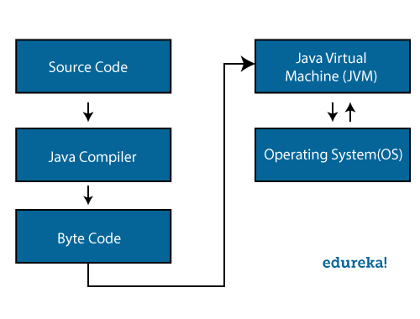
Java Architecture

Slide 18
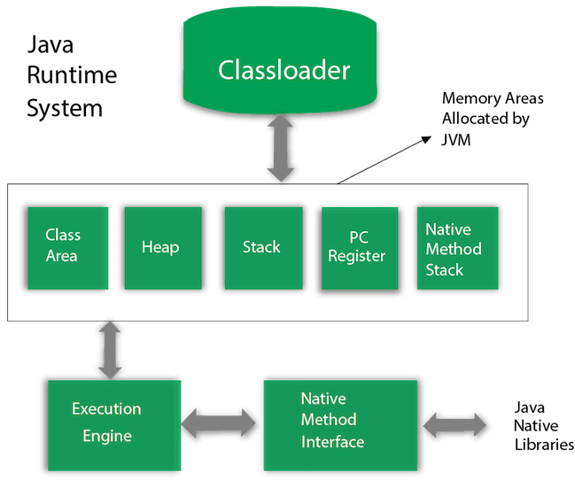

Slide 19
Java Virtual Machine
A Java virtual machine (JVM) is a virtual machine that enables a computer to run Java programs as well as programs written in other languages that are also compiled to Java bytecode. The JVM is detailed by a specification that formally describes what is required in a JVM implementation

Slide 20
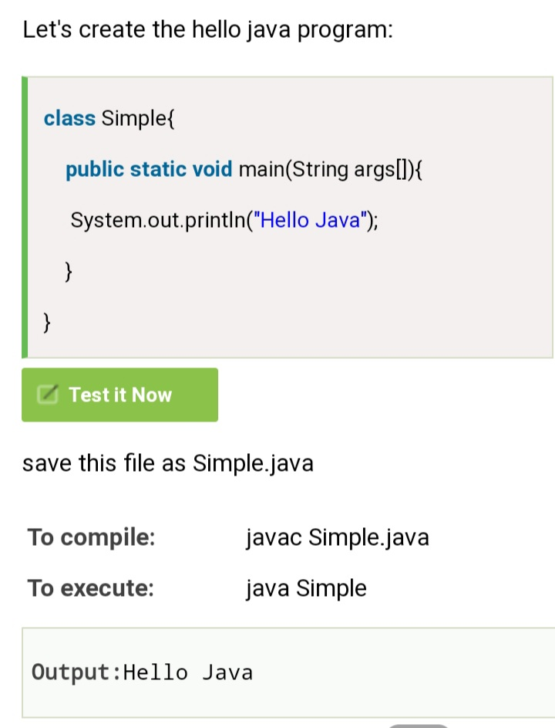

Slide 21
public class FirstProgram {
public static void main(String args[]) {
System.out.println("HI");
}
}
OUTPUT:
HI

Slide 22
pseudo code for program:
Defining a Sample Point Class
created a class point x and y
start the execution - main a b
assigning some values x and y
retriving those value assigng to a and b
displaying it.
Syntax for if else:
if(a>b){
max=a;
}
else{max =b;}
max = (a>b)?a:b;

Slide 23
EXAMPLE1
public class Point {
int X;
int Y;
void setX(int x) {
X= (x > 79 ? 79 : (x < 0 ? 0 : x));
}
void setY(int y) {
Y = (y > 24 ? 24 : (y < 0 ? 0 : y));
}
int getX() {
return X;
}
int getY() {
return Y;
}

Slide 24
public static void main(String args[]) {
int a,b;
Point p1 = new Point();
p1.setX(-2);
p1.setY(44);
System.out.println("p1.getX() "+ p1.getX());
a = p1.getX();
System.out.println("The value of a is"+a);
b = p1.getY();
System.out.println("The value of b is"+b);
}
}

Slide 25
EXAMPLE 2
public class TestVariable {
int x;
void setx(int x){
x=x;
}
int getx(){
return x;
}
public static void main(String[] args) {
TestVariable t1 = new TestVariable();
t1.setx(3);
System.out.println(t1.getx());
}
}
OUTPUT:
3

Slide 26
CONSTRUCTOR
A constructor function has the same name as the class name
A class contain more than one constructor
Facilitates multiple ways of initializing an object
Constructor therefore can be overloading.
p1 p2
Void setX (int X)
int getX()
Y………………..
int X=22
int Y=44
int X=5
int Y=20

Slide 27
public class Constuct {
int a,b;
//default constructor has no parameters
public Constuct()
{
System.out.println("I am inside constuctor");
}
public Constuct(int a, int b)
{
this.a = a;
this.b =b;
}
public static void main(String[] args) {
Constuct cs = new Constuct(2,3);
System.out.println("a>>>>"+cs.a);
System.out.println("b>>>>"+cs.b);
}
}
OUTPUT:
a>>>>2
b>>>>3

Slide 28
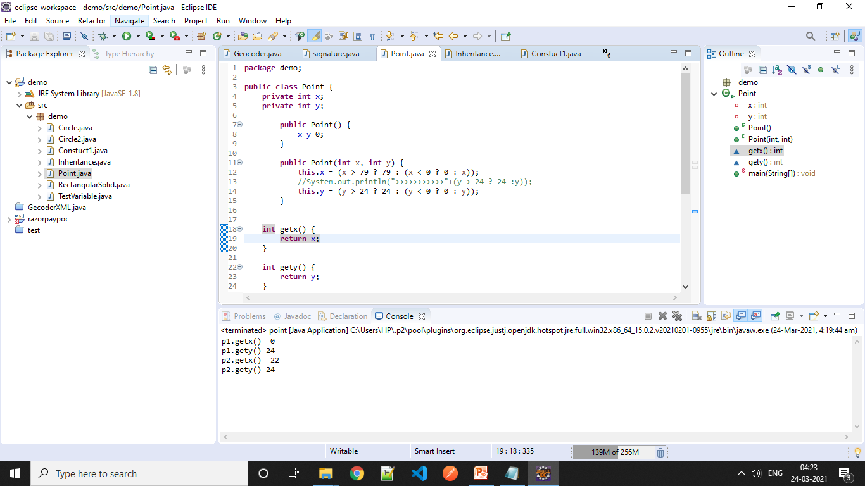
public class Point {
private int x;
private int y;
public Point() { default constructor
x=y=0;
}
public Point(int x, int y) {
this.x = (x > 79 ? 79 : (x < 0 ? 0 : x));
this.y = (y > 24 ? 24 : (y < 0 ? 0 : y)); OUTPUT:
}
int getx() {
return x;
}
int gety() {
return y;
}
public static void main(String[] args) {
Point p1 = new Point();
Point p2 = new Point(22,44);
System.out.println("p1.getx() "+ p1.getx());
System.out.println("p1.gety() "+ p2.gety());
System.out.println("p2.getx() "+ p2.getx());
System.out.println("p2.gety() "+p2.gety());
}}

Slide 29
FUNCTION SIGNATURE
A function signature consists of?
function name , the number, order and the data type of the arguments. function overloading function with same name different signature
Function power int power(int x, int y)
float power(float x, float y)

Slide 30
DATA TYPES:
Data types specify the different sizes and values that can be stored in the variable. There are two types of data types in Java:
Primitive data types: The primitive data types include Boolean , char, byte, short, int , long, float and double.
Non-primitive data types: The non-primitive data types include Classes, Interfaces, and Arrays.
type variable=value;
There are 8 types of primitive data types:
Boolean data type
byte data type
char data type
short data type
int data type
long data type
float data type
double data type

Slide 31
Integer:
int 32 bits
- long 64 bits
- short 16 bits
- byte 8 bits
Character:
-char 16 bits, UNICODE Character
-String(is an object in Java)
Floating point:
float 32 bits
- double 64 bits
Boolean:
- true or false

Slide 32
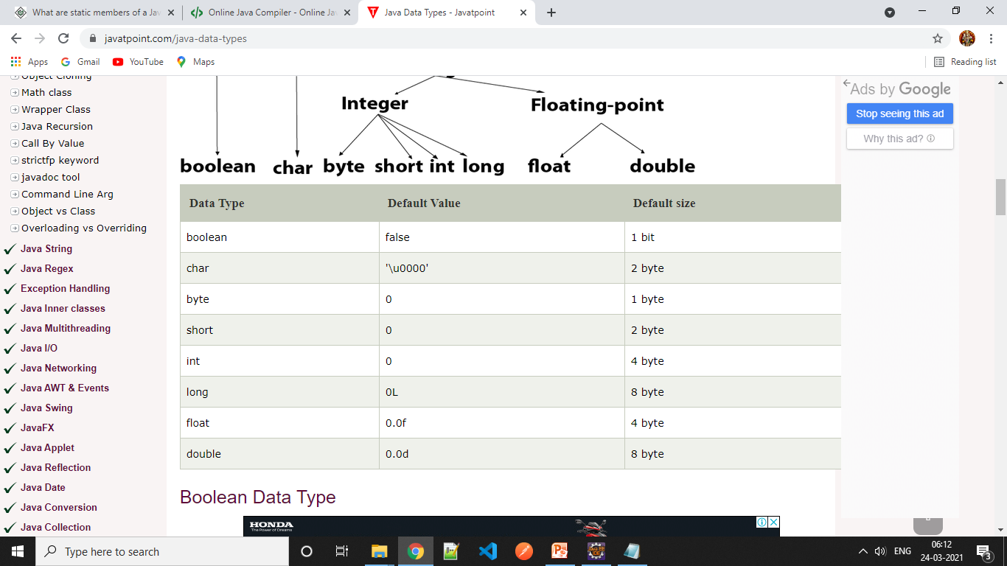

Slide 33
Boolean Data Type:
The Boolean data type is used to store only two possible values: true and false. This data type is used for simple flags that track true/false conditions.
Example: Boolean one = false
Byte Data Type:
The byte data type is an example of primitive data type. It is an 8-bit signed two's complement integer. Its value-range lies between -128 to 127 (inclusive). Its minimum value is -128 and maximum value is 127. Its default value is 0.
Example: byte a = 10, byte b = -20
Short Data Type:
The short data type is a 16-bit signed two's complement integer. Its value-range lies between -32,768 to 32,767 (inclusive). Its minimum value is -32,768 and maximum value is 32,767. Its default value is 0.
Example: short s = 10000, short r = -5000

Slide 34
Int Data Type
The int data type is generally used as a default data type for integral values unless if there is no problem about memory.
Example: int a = 100000, int b = -200000
Long Data Type
The long data type is a 64-bit two's complement integer. Its value-range lies between -9,223,372,036,854,775,808(-2^63) to The long data type is used when you need a range of values more than those provided by int.
Example: long a = 100000L, long b = -200000L
Float Data Type
The float data type is a single-precision 32-bit IEEE 754 floating point . Its value range is unlimited. It is recommended to use a float (instead of double) if you need to save memory in large arrays of floating point numbers. The float data type should never be used for precise values, such as currency. Its default value is 0.0F.
Example: float f1 = 234.5f

Slide 35
Double Data Type:
The double data type is a double-precision 64-bit IEEE 754 floating point. Its value range is unlimited. The double data type is generally used for decimal values just like float. The double data type also should never be used for precise values, such as currency. Its default value is 0.0d.
Example: double d1 = 12.3
Char Data Type:
The char data type is a single 16-bit Unicode character. The char data type is used to store characters.
Example: char letterA = 'A'

Slide 36
UNICODE SYSTEM
Unicode is a universal international standard character encoding that is capable of representing most of the world's written languages.
Before Unicode, there were many language standards:
ASCII (American Standard Code for Information Interchange) for the United States. ISO 8859-1 for Western European Language. KOI-8 for Russian. GB18030 and BIG-5 .

Slide 37
STATIC CLASS MEMBER
In Java, static members are those which belongs to the class and you can access these members without instantiating the class.
The static keyword can be used with methods, fields, classes (inner/nested), blocks.
Static Methods − You can create a static method by using the keyword static. Static methods can access only static fields, methods. To access static methods there is no need to instantiate the class, you can do it just using the class name.
EG: public class MyClass {
public static void sample()
{
System.out.println("Hello");
}
public static void main(String args[])
{
MyClass.sample();
}
}
Output:
Hello

Slide 38
Static Fields − You can create a static field by using the keyword static. The static fields have the same value in all the instances of the class. These are created and initialized when the class is loaded for the first time. Just like static methods you can access static fields using the class name (without instantiation).
EG:
public class MyClass
{
public static int data = 20;
public static void main(String args[])
{
System.out.println(MyClass.data);
}
Java Arrays with Answers 27
}
Output:
20

Slide 39
Garbage collection
Java applications obtain objects in memory as needed. It is the task of garbage collection (GC) in the Java virtual machine (JVM) to automatically determine what memory is no longer being used by a Java application and to recycle this memory for other uses.
Because memory is automatically reclaimed in the JVM, Java application developers are not burdened with having to explicitly free memory objects that are not being used.

Slide 40
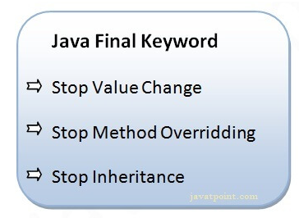
FINAL KEYWORD
The final keyword in java is used to restrict the user. The java final keyword can be used in many context. Final can be:
variable
method
class
The final keyword can be applied with the variables, a final variable that have no value it is called blank final variable or uninitialized final variable. It can be initialized in the constructor only. The blank final variable can be static also which will be initialized in the static block only.

Slide 41
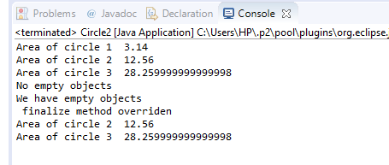
public class Circle2 {
static double pi = 3.14;
public double area(int r) {
return pi*r*r;
}
public static void main(String[] args) {
Circle2 c1 = new Circle2();
System.out.println(( "Area of circle 1 "+c1.area(1)));
Circle2 c2 = new Circle2();
System.out.println(( "Area of circle 2 "+c2.area(2)));
Circle2 c3 = new Circle2();
System.out.println(( "Area of circle 3 "+c3.area(3)));
System.gc();
System.out.println("No empty objects");
c1= null; OUTPUT:
System.gc();
System.out.println("We have empty objects"); OUTPUT:
System.out.println(( "Area of circle 2 "+c2.area(2)));
System.out.println(( "Area of circle 3 "+c3.area(3)));
}
public void finalize() {
System.out.println(" finalize method overriden");
}}

Slide 42
INHERITANCE
Inheritance in Java is a mechanism in which one object acquires all the properties and behaviors of a parent object. It is an important part of OOPs (Object Oriented programming system).The idea behind inheritance in Java is that you can create new classes that are built upon existing classes. When you inherit from an existing class, you can reuse methods and fields of the parent class.
Class: A class is a group of objects which have common properties. It is a template or blueprint from which objects are created.
Sub Class/Child Class: Subclass is a class which inherits the other class. It is also called a derived class, extended class, or child class.
Super Class/Parent Class: Superclass is the class from where a subclass inherits the features. It is also called a base class or a parent class.
Reusability: As the name specifies, reusability is a mechanism which facilitates you to reuse the fields and methods of the existing class when you create a new class. You can use the same fields and methods already defined in the previous class.
The syntax of Java Inheritance
class Subclass-name extends Superclass-name
{
//methods and fields
}

Slide 43
ACCESS SUPER CLASS
class A1{
int money;
private int pocketmoney;
void fill(int money, int pocketmoney) {
this.money=money;
this.pocketmoney=pocketmoney;
}
public int getPocketmoney()
{
return pocketmoney;
}
}
class B1 extends A1{
int total;
void sum() {
total = money +getPocketmoney();
}}

Slide 44
class AcessDemo{
public static void main(String[] args) {
B1 suboj = new B1();
suboj.fill(122, 200);
suboj.sum();
System.out.println(" Total :"+ suboj.total);
}
}
OUTPUT:
Total :322

Slide 45
EXAMPLE:
class A{
int m,n;
void display() {
System.out.println("m and n are "+m+" "+n);
}
}
class B extends A{
int c;
void display2() {
System.out.println("c : "+c);
}
void sum()
{
System.out.println(" m+n+ c "+(m+n+c));
}
}

Slide 46
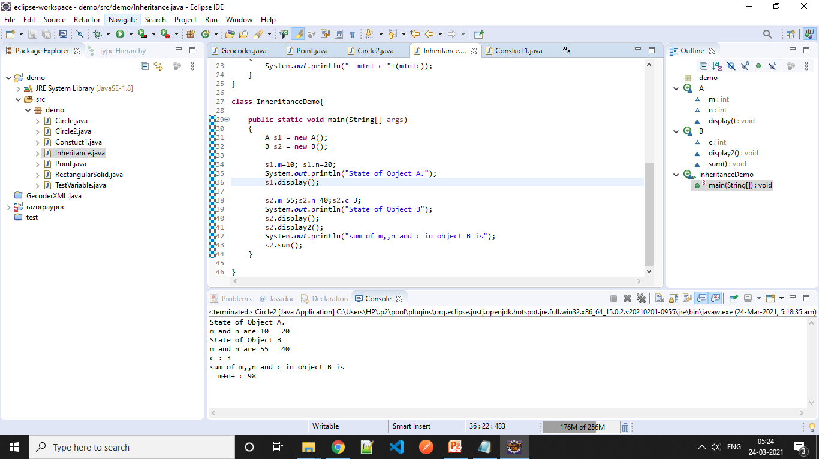
class InheritanceDemo{
public static void main(String[] args)
{
A s1 = new A();
B s2 = new B();
s1.m=10; s1.n=20;
System.out.println("State of Object A.");
s1.display();
s2.m=55;s2.n=40;s2.c=3;
System.out.println("State of Object B");
s2.display();
s2.display2();
System.out.println("sum of m,,n and c in object B is");
s2.sum(); OUTPUT:
}
}

Slide 47
RectangularSolid
public class RectangularSolid {
double width;
double height;
double depth;
RectangularSolid(double w, double height, double d){
width = w;
this.height = height;
depth =d;
}
RectangularSolid( double length){
width=height=depth=length;
}
RectangularSolid(){
width=height=depth=10;
}
double volume() {
return width*height*depth;
}
}

Slide 48
class RectangularSolidWeight extends RectangularSolid{
double weight;
RectangularSolidWeight(double w, double h, double d, double wt){
width=w;
height=h;
depth=d;
weight=wt;
}
}
class RectangularSolidImpl
{
public static void main(String args[])
{
RectangularSolidWeight r1 = new RectangularSolidWeight(10,20,15,35);
RectangularSolidWeight r2 = new RectangularSolidWeight(1,2,3,5);

Slide 49
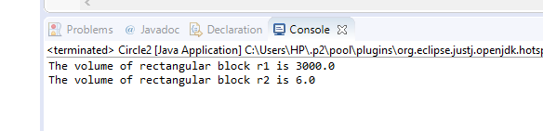
double volume;
volume = r1.volume();
System.out.println("The volume of rectangular block r1 is "+ volume);
volume = r2.volume();
System.out.println("The volume of rectangular block r2 is "+ volume);
}
}
OUTPUT:

Slide 50
INTERVIEW QUESTIONS
what is variable - A variable is an item of data named by an identifier. You must explicitly provide a name and a type for each variable you want to use in your program
What is scope - The section of code where the variable's simple name can be used
How will you declare a variable you explicitly set the variable's name and data type
In java how many categories of data type are available? two categories of data - primitive and reference or Non primitive.
What defines the scope of a variable?
Location of a variable set the variable scope

Slide 51
How many types of categories of scope and what are they?
Four categories of scope: member variable scope, local variable scope, parameter scope, and exception handler parameter scope.
How many integrals are in java programming languages?
Four- byte,short,int and long
How you represent literals of integral types?
Decimal, octal, hexa decimal

